Slide 1
Working with Databases

Slide 2
Table of Contents
What is database
Code first and database first
Configuration and connection string
Database context class
DB Entity classes
Database Migrations
Scaffolding
CRUD

Slide 3
What is database

Slide 4
Database
A database is a data structure that stores organized information.
Most databases contain multiple tables, which may each include several different fields.
For example, a company database may include tables for products, employees, and financial records.
Each of these tables would have different fields that are relevant to the information stored in the table.

Slide 5
Databases
Nearly all e-commerce sites uses databases to store product inventory and customer information. These sites use a database management system (or DBMS), such as Microsoft SQL Server or MySQL as the "back end" to the website.
By storing website data in a database, the data can be easily searched, sorted, and updated. This flexibility is important for e-commerce sites and other types of dynamic websites.
Early databases were relatively "flat," which means they were limited to simple rows and columns, like a spreadsheet.
Relational databases allow users to access, update, and search information based on the relationship of data stored in different tables. Relational databases can also run queries that involve multiple databases.
While early databases could only store text or numeric data, modern databases also let users store other data types such as sound clips, pictures, and videos.

Slide 6
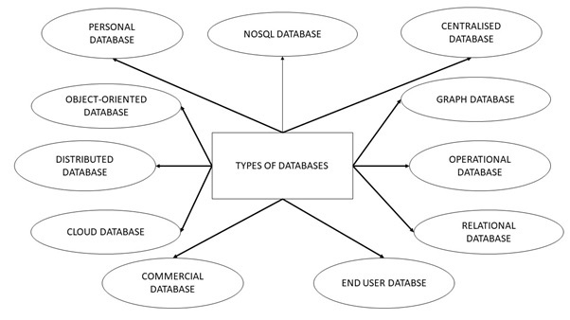
Types of databases
https://www.tutorialspoint.com/Types-of-databases

Slide 7
Code first and database first

Slide 8
Code First Approach
In code first approach we first create entity classes with properties defined in it. Entity framework will create the database and tables based on the entity classes defined. So database is generated from the code. When the dot net code is run database will get created.
Advantages
You can create the database and tables from your business objects.
You can specify which related collections are to be eager loaded, or not be serialized at all.
Database version control.
Good for small applications.
Disadvantages
You have to write everything related to database in the visual studio code.
For stored procedures you have to map stored procedure using Fluent API and write Stored Procedure inside the code.
If you want to change anything in the database tables you to make changes in the entity classes in the code file and run the update-database from the package manager console.
Not preferred for Data intensive applications.

Slide 9
Database First Approach
In this approach Database and tables are created first. Then you create entity Data Model using the created database.
Advantages
Simple to create the data model
Graphical user interface.
Mapping and creation of keys and relationships are easy as you need not have to write any code .
Preferred for data intense and large applications
Disadvantages
Using an existing database to generate a .edmx model file and the associated code models results in a giant pile of auto generated code.
When you need to add any functionality to generated model you have to extend the model class generated.
Choosing the appropriate approach is purely based on the applications you are developing.

Slide 10
Configuration and connection string

Slide 11
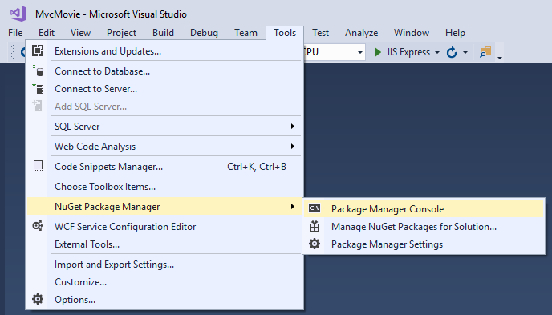
Add NuGet packages
In the PMC, run the following command:
Install-Package Microsoft.EntityFrameworkCore.SqlServer

Slide 12
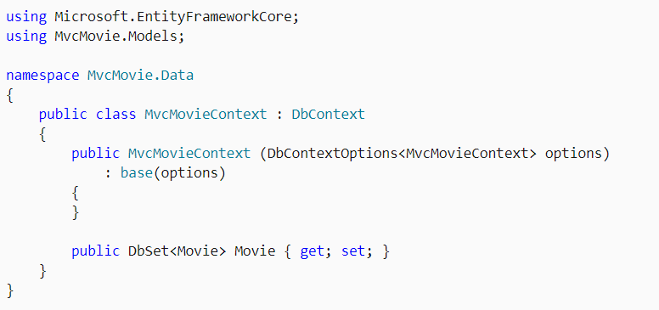
Create a database context class
A database context class is needed to coordinate EF Core functionality (Create, Read, Update, Delete) for the Movie model. The database context is derived from Microsoft.EntityFrameworkCore.DbContext and specifies the entities to include in the data model.
Create a Data folder.
Add a Data/MvcMovieContext.cs file with the following code:

Slide 13
DB Entity classes

Slide 14
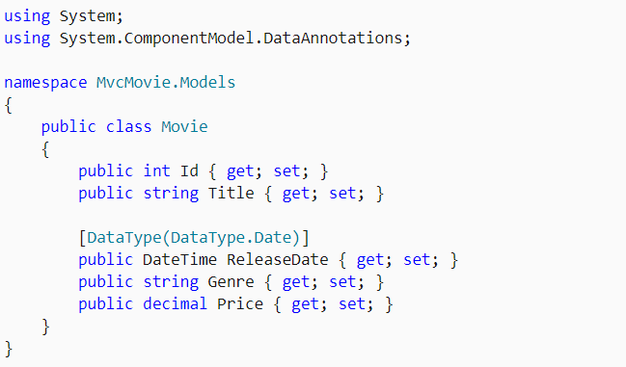
Add a data model class
Right-click the Models folder > Add > Class. Name the file Movie.cs.

Slide 15
Database context class

Slide 16
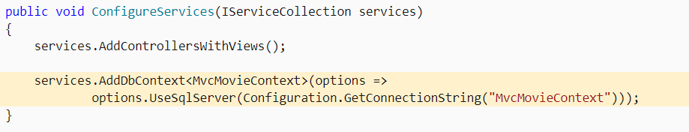
Register the database context
ASP.NET Core is built with dependency injection (DI). Services (such as the EF Core DB context) must be registered with DI during application startup.
Add the following highlighted code in Startup.ConfigureServices:

Slide 17
Add a database connection string
Add a connection string to the appsettings.json file:
{
"Logging": {
"LogLevel": {
"Default": "Information",
"Microsoft": "Warning",
"Microsoft.Hosting.Lifetime": "Information"
}
},
"AllowedHosts": "*",
"ConnectionStrings": {
"MvcMovieContext": "Server=(localdb)\\mssqllocaldb;Database=MvcMovieContext-1;Trusted_Connection=True;MultipleActiveResultSets=true"
}
}

Slide 18
Database Migrations

Slide 19

Initial migration
Migrations is a set of tools that let you create and update a database to match your data model.
From the Tools menu, select NuGet Package Manager > Package Manager Console (PMC).
In the PMC, enter the following commands:

Slide 20
Initial migration
Add-Migration InitialCreate: Generates a Migrations/{timestamp}_InitialCreate.cs migration file. The InitialCreate argument is the migration name. Any name can be used, but by convention, a name is selected that describes the migration. Because this is the first migration, the generated class contains code to create the database schema. The database schema is based on the model specified in the MvcMovieContext class.
Update-Database: Updates the database to the latest migration, which the previous command created. This command runs the Up method in the Migrations/{time-stamp}_InitialCreate.cs file, which creates the database.

Slide 21
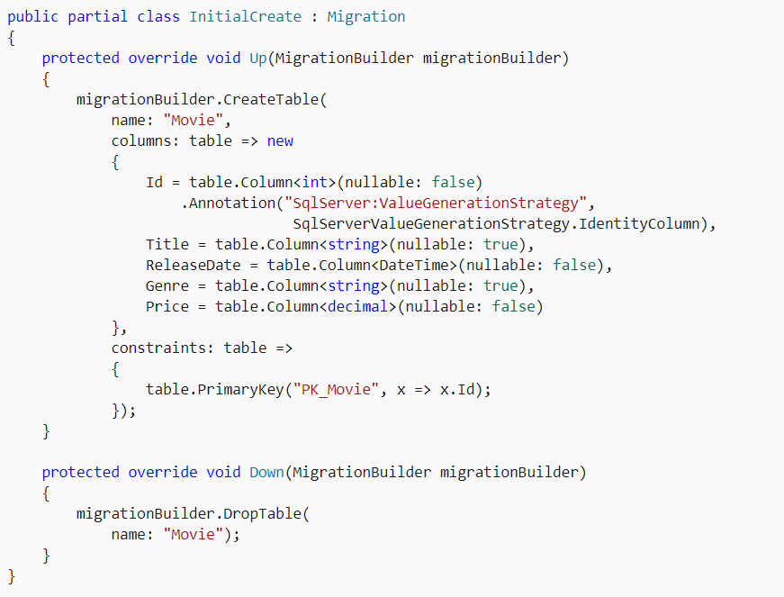
The InitialCreate class

Slide 22
Seed the database
If you wish to add some initial data into your database, you can do the following:
Create a new class named SeedData in the Models folder.
Add the seed initializer
https://docs.microsoft.com/en-us/aspnet/core/tutorials/first-mvc-app/working-with-sql

Slide 23
Scaffolding

Slide 24
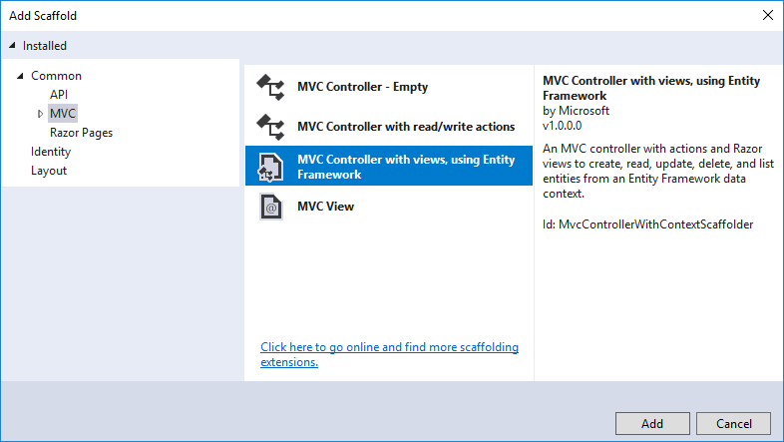
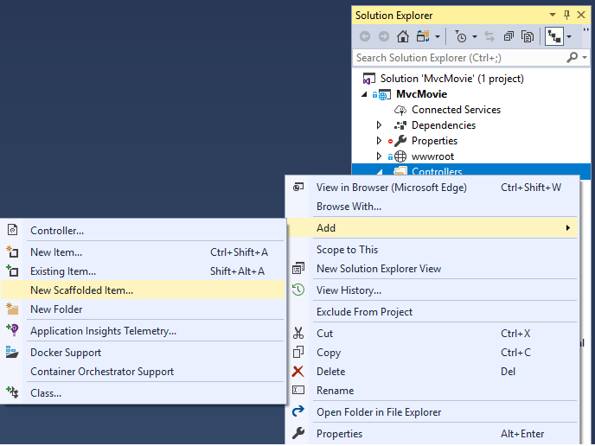
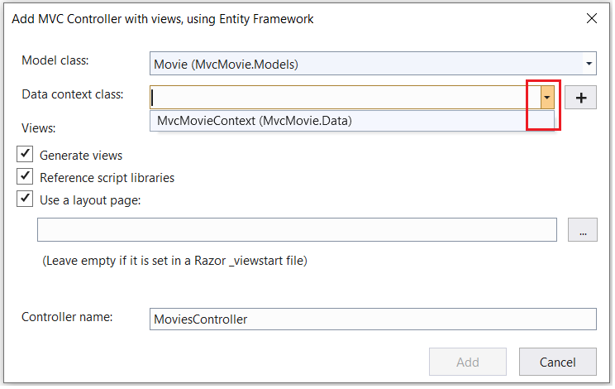
Scaffold movie pages
Use the scaffolding tool to produce Create, Read, Update, and Delete (CRUD) pages for the movie model.

Slide 25
Scaffold movie pages
Visual Studio creates:
A movies controller (Controllers/MoviesController.cs)
Razor view files for Create, Delete, Details, Edit, and Index pages (Views/Movies/*.cshtml)
The automatic creation of these files is known as scaffolding.

Slide 26
CRUD
Live Demo

Slide 27
Adding search

Slide 28
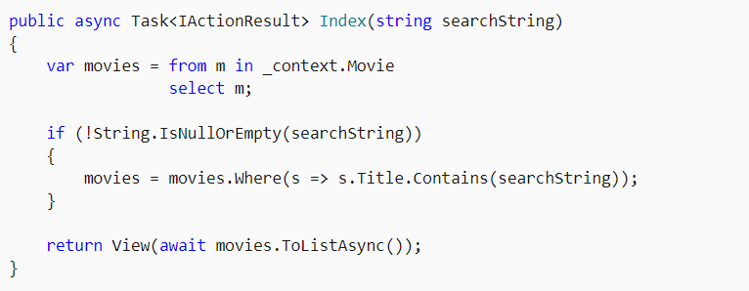
Adding Search – Modify Action
Update the Index method found inside Controllers/MoviesController.cs with the following code:

Slide 29
Lambda expressions
The s => s.Title.Contains() code above is a Lambda Expression.
Lambdas are used in method-based LINQ queries as arguments to standard query operator methods such as the Where method or Contains (used in the code above). LINQ queries are not executed when they're defined or when they're modified by calling a method such as Where, Contains, or OrderBy. Rather, query execution is deferred. That means that the evaluation of an expression is delayed until its realized value is actually iterated over or the ToListAsync method is called. For more information about deferred query execution, see Query Execution.
Note: The Contains method is run on the database, not in the c# code shown above. The case sensitivity on the query depends on the database and the collation. On SQL Server, Contains maps to SQL LIKE, which is case insensitive. In SQLite, with the default collation, it's case sensitive.

Slide 30
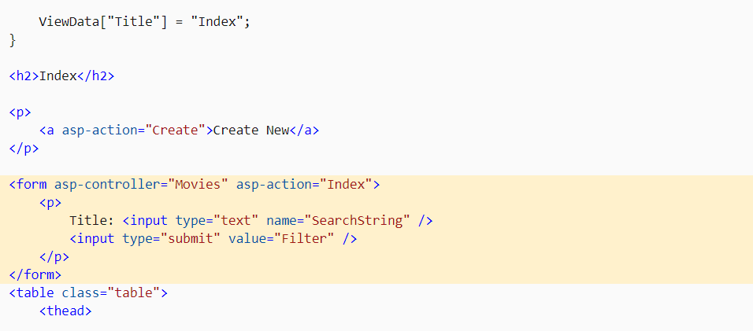
Adding Search – Modify View
Add FORM
Try POST and GET realizations

Slide 31
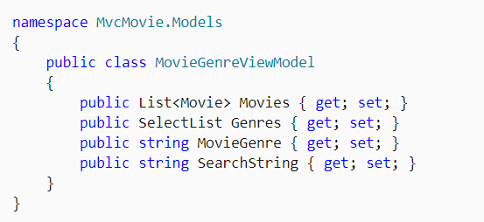
Search by genre
Add the following MovieGenreViewModel class to the Models folder
The movie-genre view model will contain:
A list of movies.
A SelectList containing the list of genres. This allows the user to select a genre from the list.
MovieGenre, which contains the selected genre.
SearchString, which contains the text users enter in the search text box.

Slide 32
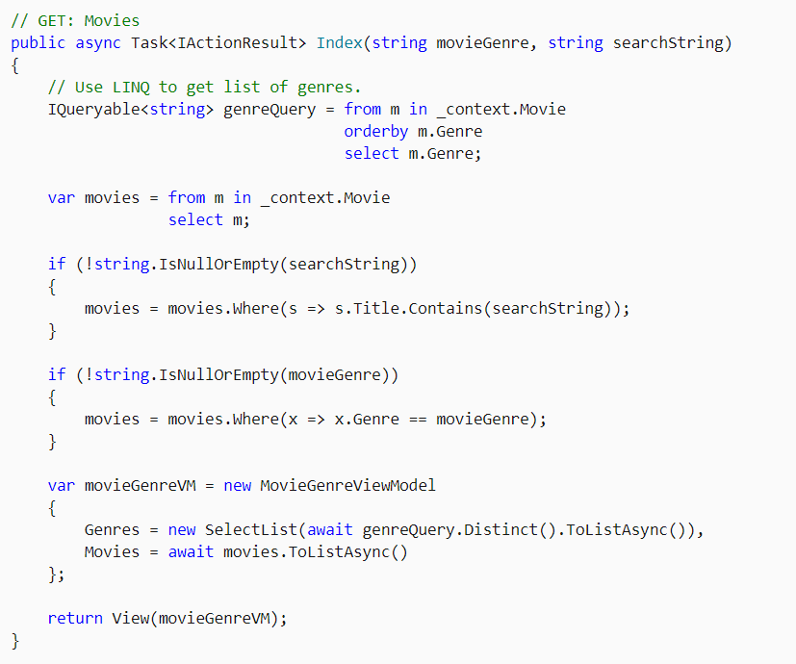
Search by genre - Action

Slide 33
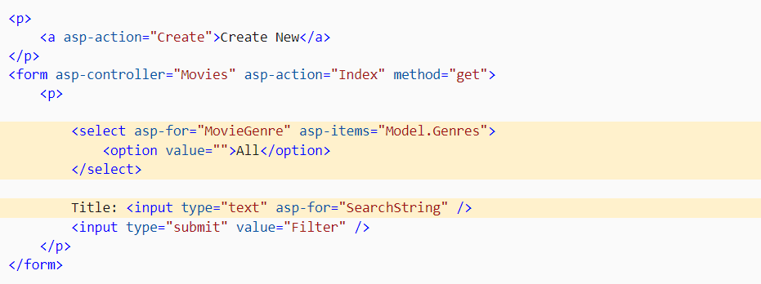
Search by genre - View
Modify Form

Slide 34
Add a new field
In this section Entity Framework Code First Migrations is used to:
Add a new field to the model.
Migrate the new field to the database.
When EF Code First is used to automatically create a database, Code First:
Adds a table to the database to track the schema of the database.
Verifies the database is in sync with the model classes it was generated from. If they aren't in sync, EF throws an exception. This makes it easier to find inconsistent database/code issues.

Slide 35
Add new field - Action
Because we’ve added a new field to the Movie class, we need to update the property binding list so this new property will be included. In MoviesController.cs, update the [Bind] attribute for both the Create and Edit action methods to include the Rating property:

Slide 36
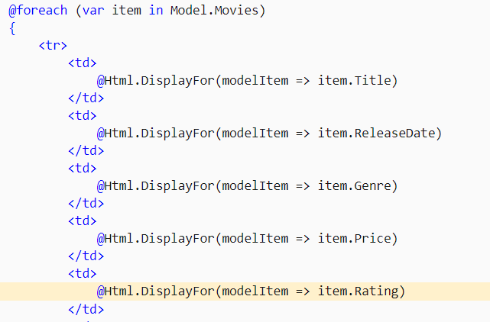
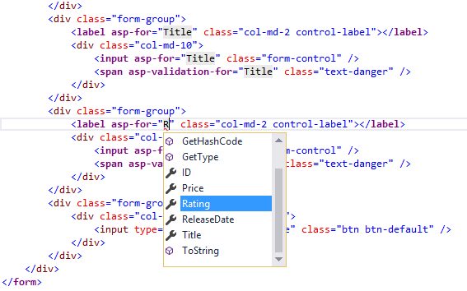
Add new field - Views
List
Edit

Slide 37
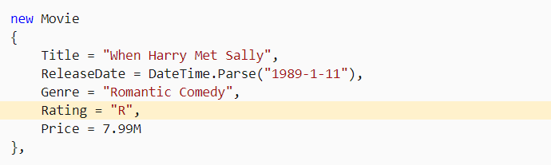
Add new field – Seed data
Update the SeedData class so that it provides a value for the new column. A sample change is shown below, but you'll want to make this change for each new Movie.

Slide 38

Add new field – Migration
In the PMC, enter the following commands:
The Add-Migration command tells the migration framework to examine the current Movie model with the current Movie DB schema and create the necessary code to migrate the DB to the new model.
The name "Rating" is arbitrary and is used to name the migration file. It's helpful to use a meaningful name for the migration file.
If all the records in the DB are deleted, the initialize method will seed the DB and include the Rating field.

Slide 39
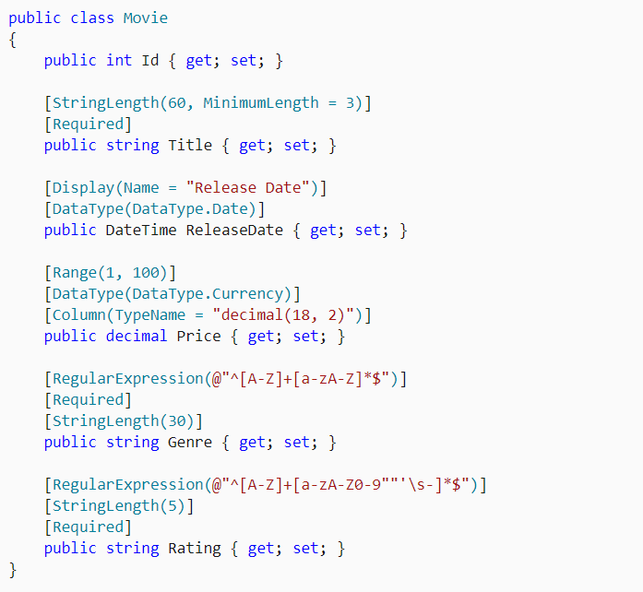
Add validation
Modify Movie model by adding validation rules
https://docs.microsoft.com/en-us/aspnet/core/tutorials/first-mvc-app/validation

Slide 40
References
https://docs.microsoft.com/en-us/aspnet/core/tutorials/first-mvc-app/start-mvc
https://www.c-sharpcorner.com/blogs/entity-framework-code-first-vs-database-first-approach
https://docs.microsoft.com/en-us/aspnet/core/mvc/views/tag-helpers/intro?view=aspnetcore-5.0
https://docs.microsoft.com/en-us/dotnet/csharp/language-reference/operators/lambda-expressions
https://docs.microsoft.com/en-us/aspnet/core/mvc/overview?view=aspnetcore-5.0

Slide 41
Homework – Students, part 2
Create new ASP.NET Core MVC web project using the default template
Create a registration form with appropriate validation, containing following fields:
First name – string, required
Last name – string, required
Email – email, required
Gender – radio button with options man, woman, other
Subscribe me – checkbox, Boolean
Country – list of countries, required
Photo – file
Implement functionality to save information in the database
Create a page displaying list of all students with links to Add, Delete, Edit*

